Slide 1
Flight reservation

Slide 2
Technologies use
Html
Css
JavaScript
Bootstrap
Node JS
React JS

Slide 3
First create angular project using
Install node js
Check node js version using command as node --version
Check npm command version using command as npm --version
Then install ng command using npm install –g create-react-app
Then create the project using command as
create-react-app flight-booking

Slide 4
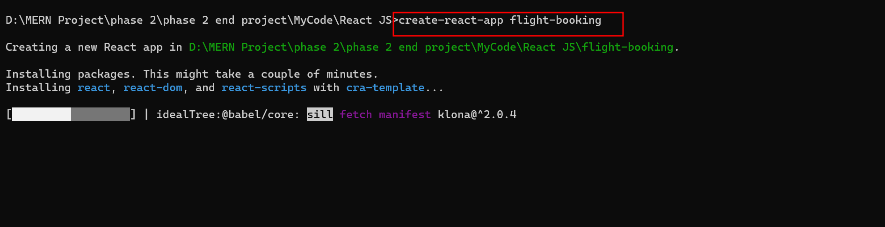
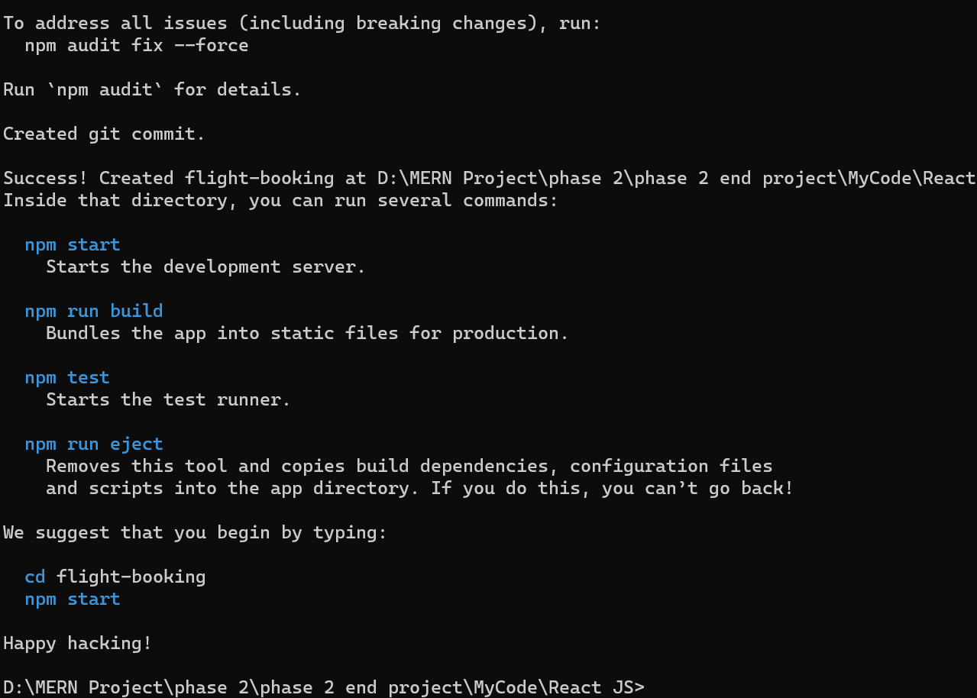

Slide 5
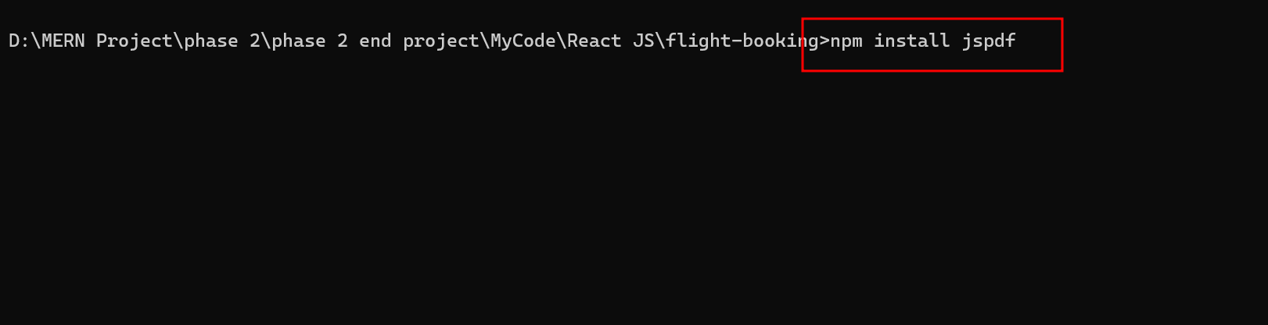
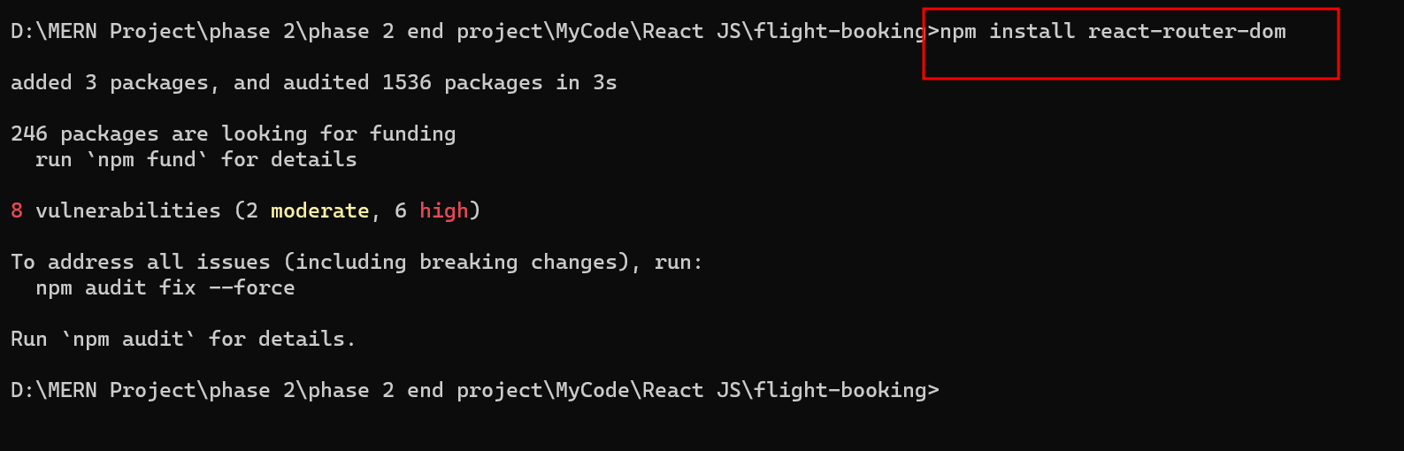
Now we need to install required dependencies
Move inside a project folder and install below dependencis
npm install
Which help to download required dependencies.

Slide 6
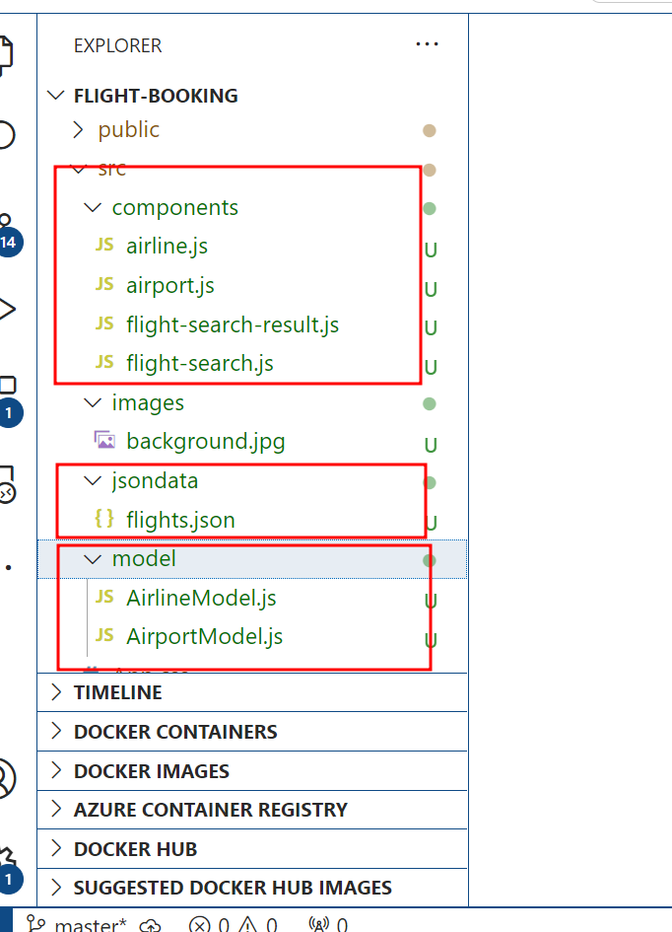
The project structure
Open the project in VS Code

Slide 7
Short description
component created :
airline.js
airport.js
flight-search.js
flight-search-result.js
App.js
model
AirlineModel.js
AirpotModel.js
jsondata
flights.json
css
App.css

Slide 8
To run the project
First run the command as npm install inside a : flight-booking folder.
Then run the command as npm start to run the project.
After compiled program successfully open the browser and write the URL as http://localhost:3000

Slide 9
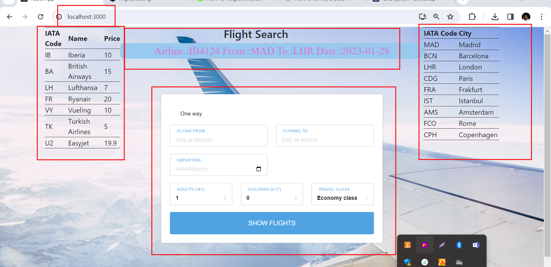

Slide 10
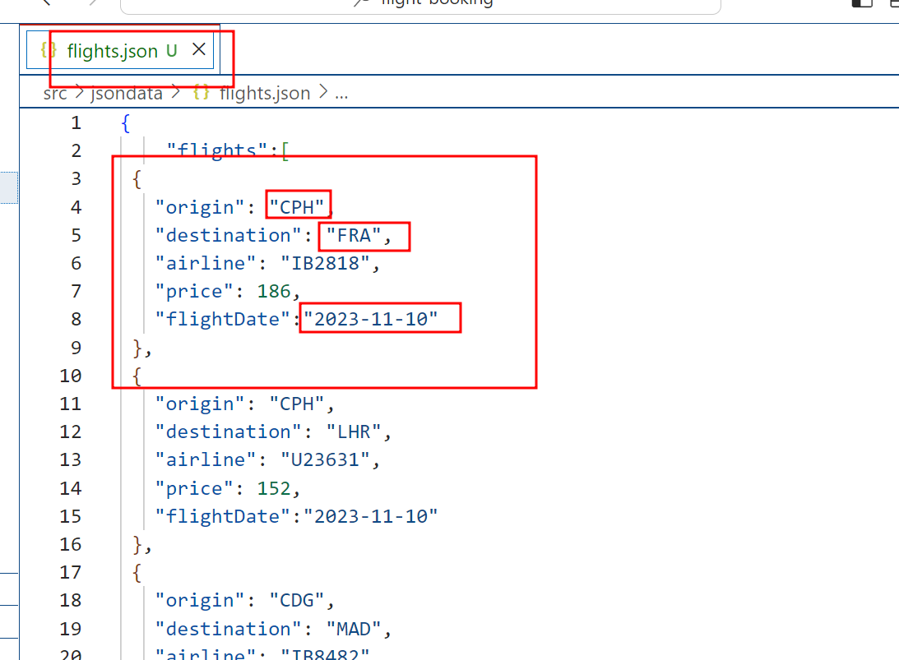

Slide 11
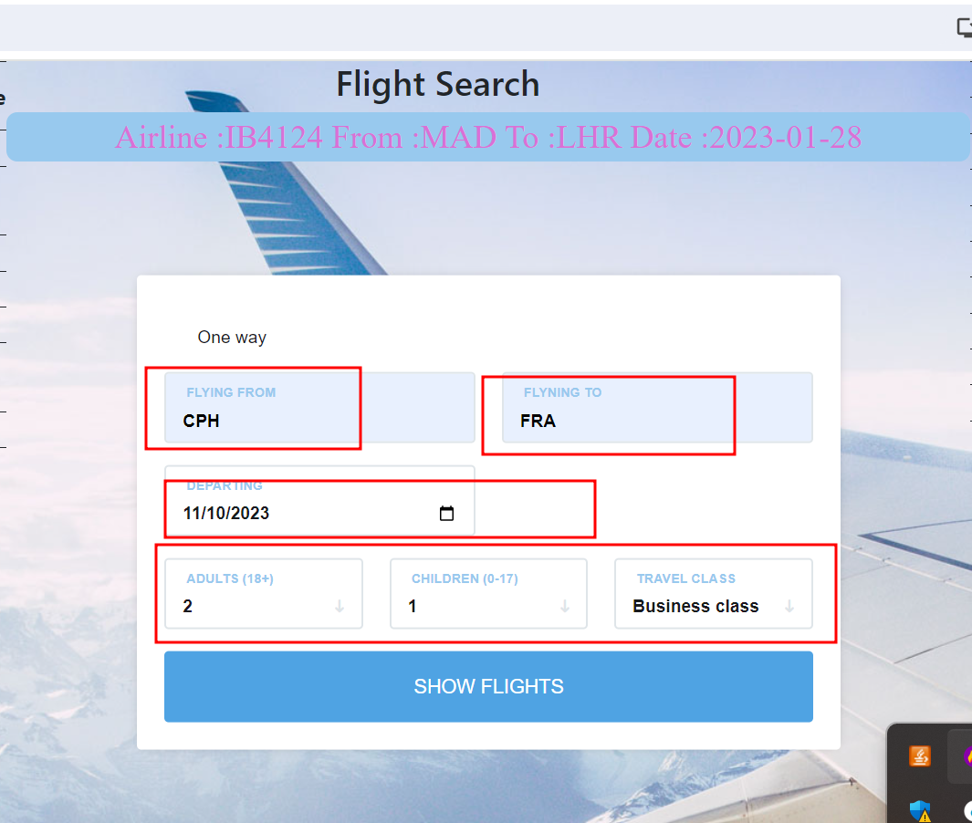

Slide 12
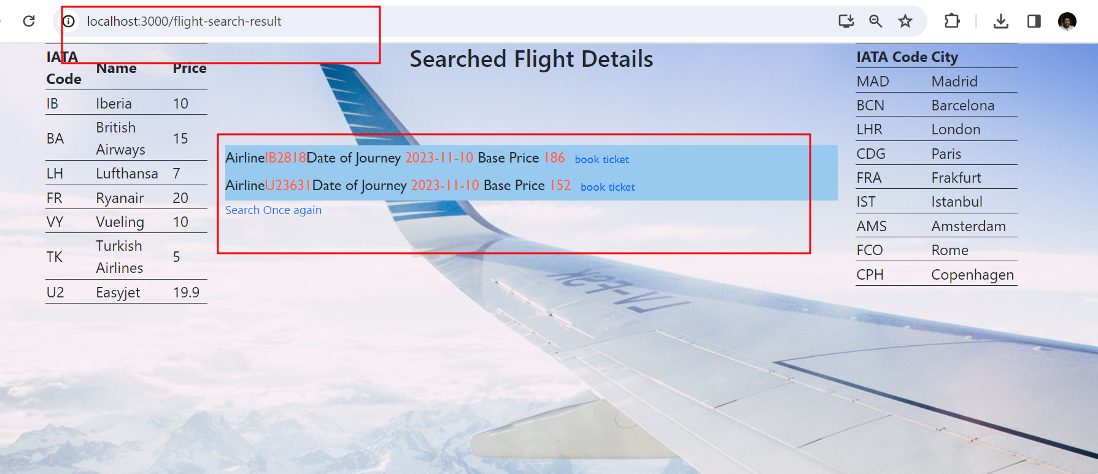

Slide 13
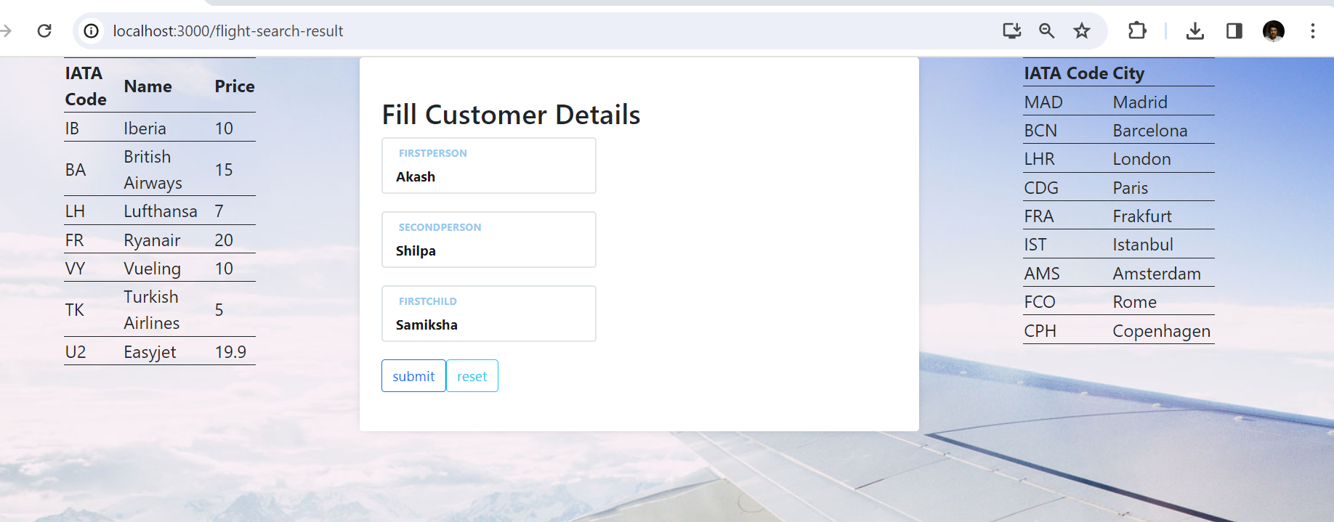

Slide 14
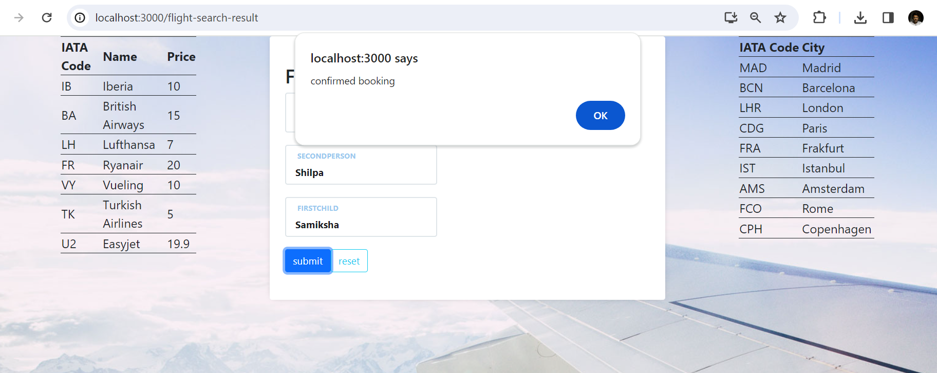

Slide 15
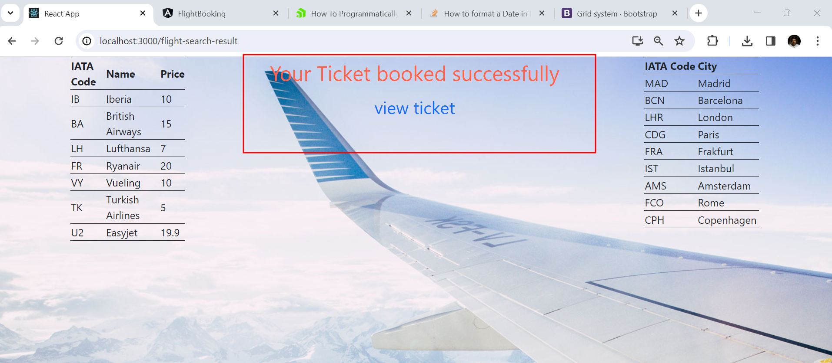

Slide 16
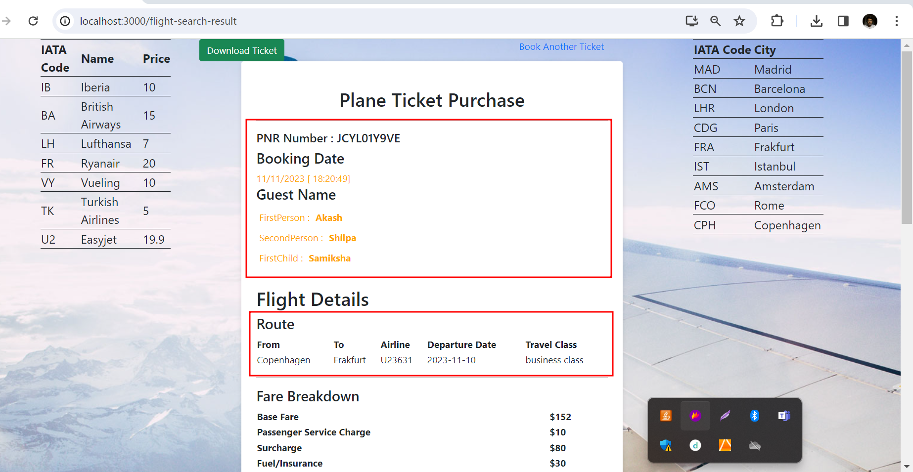

Slide 17
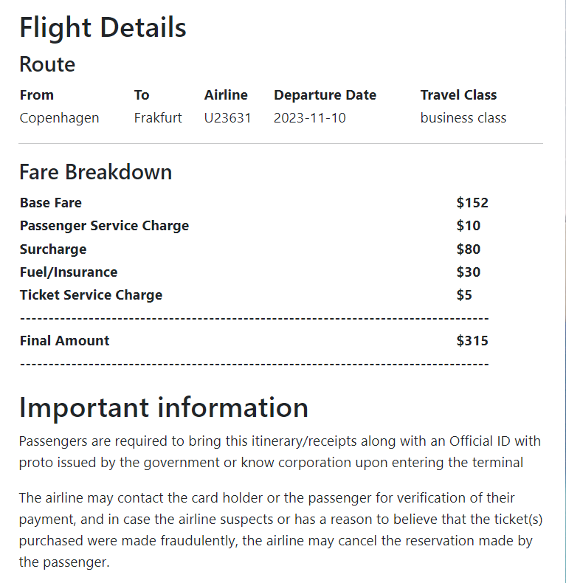

Slide 18
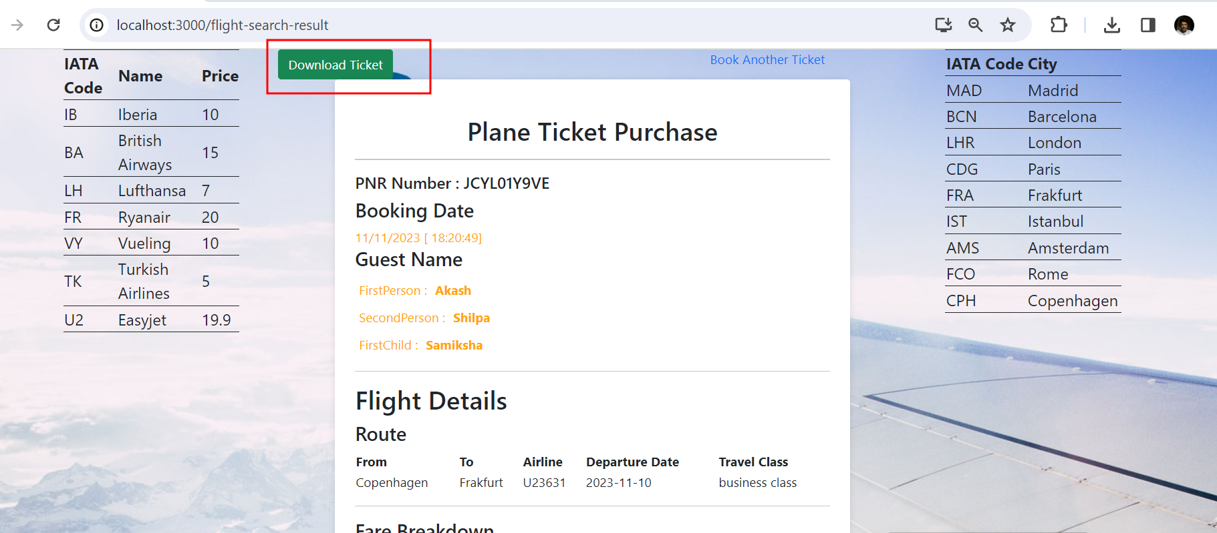

Slide 19
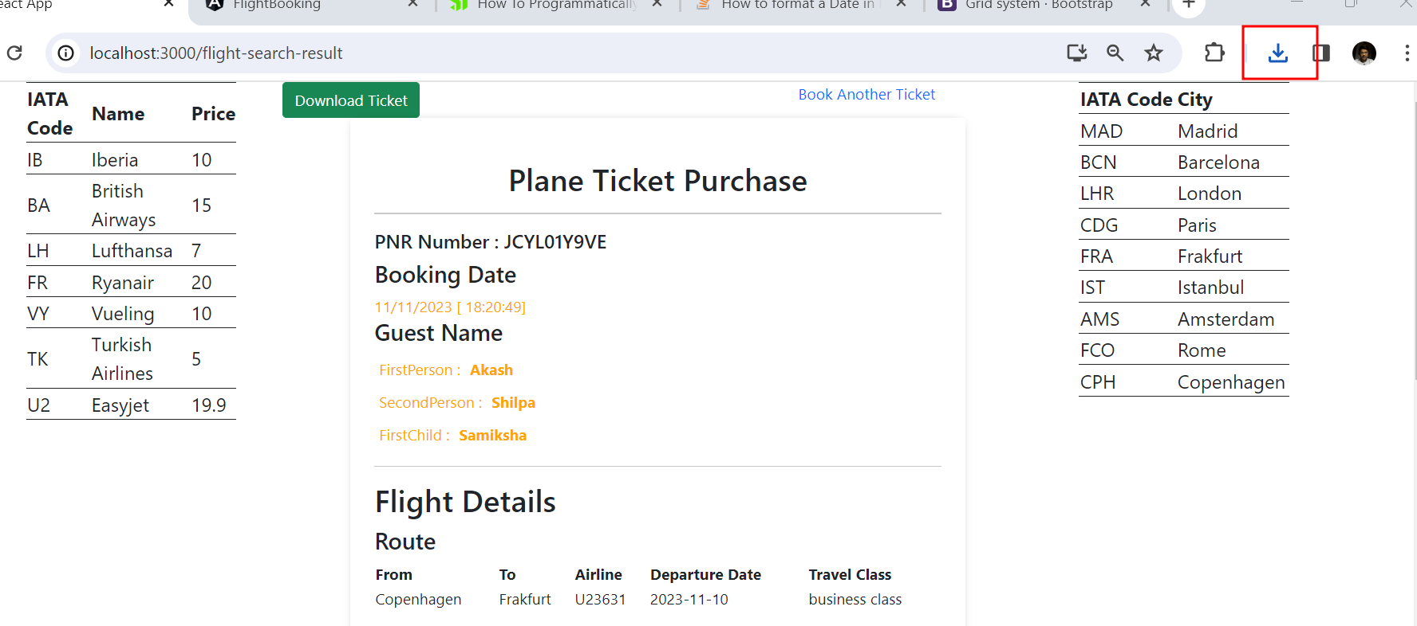

Slide 20
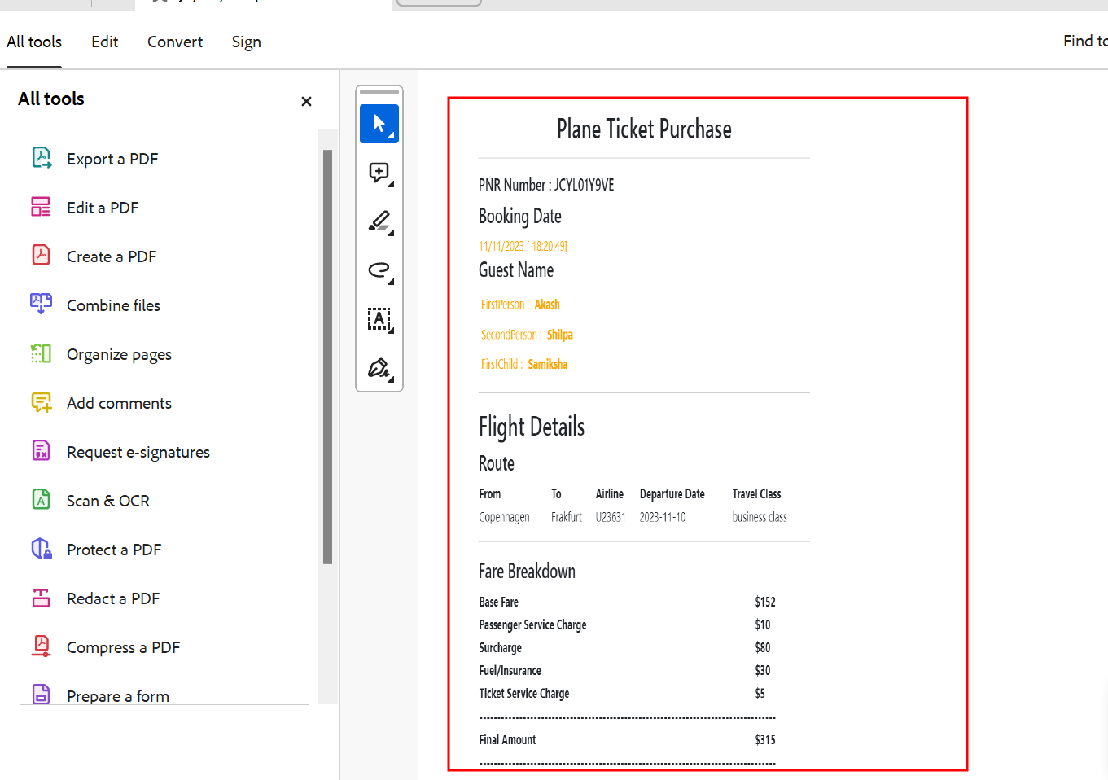

Slide 21
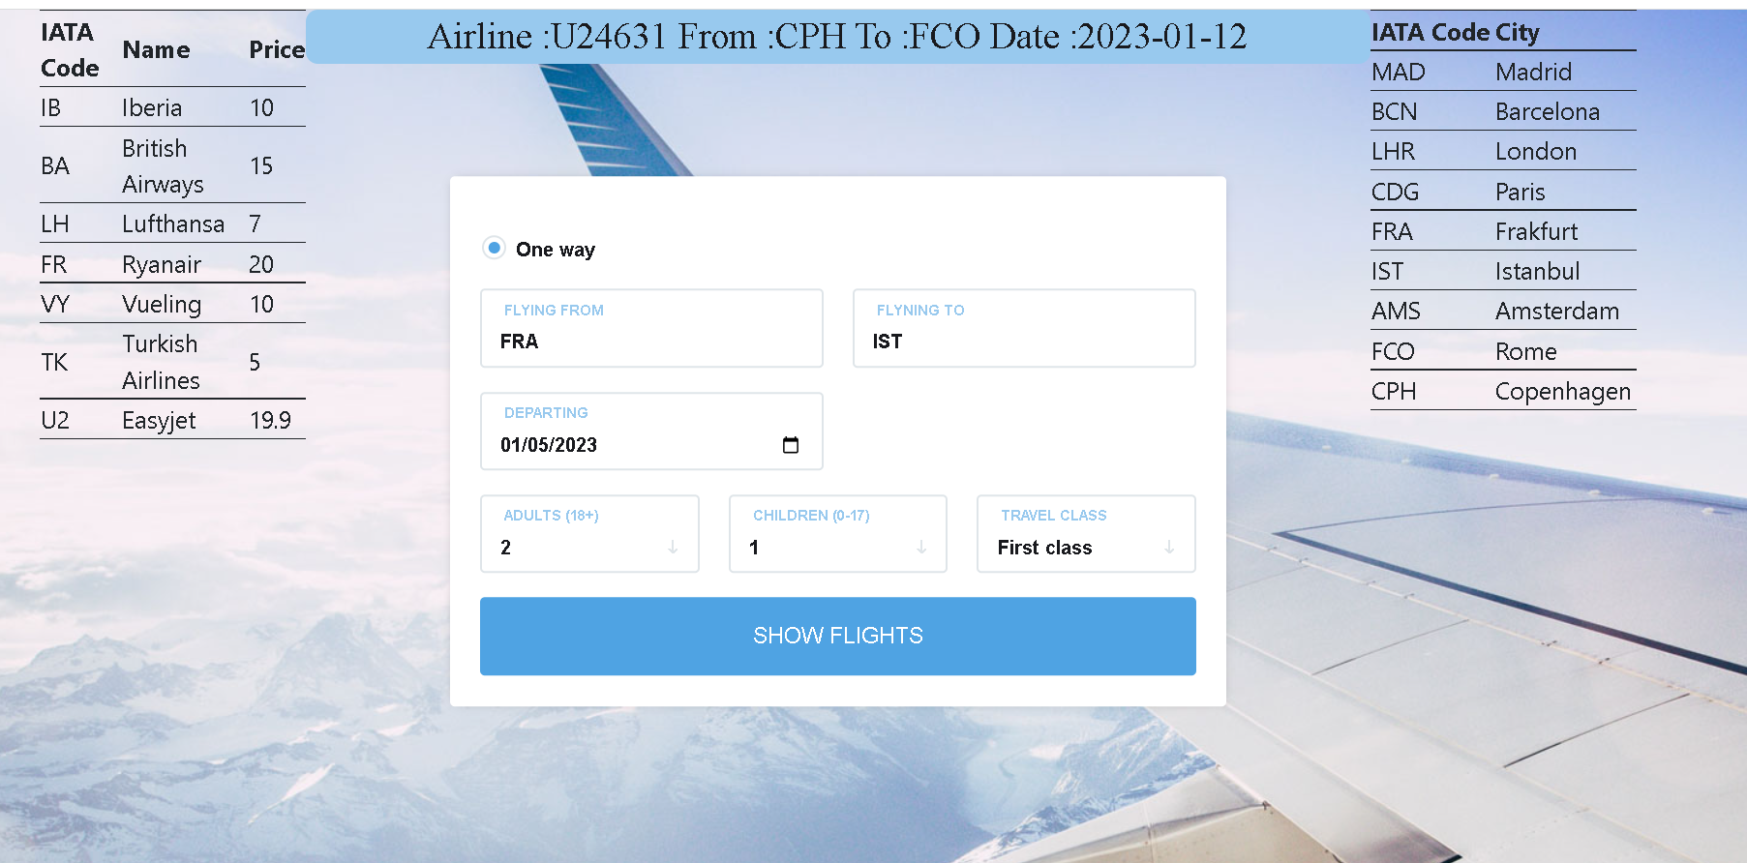
We can search the flight

Slide 22
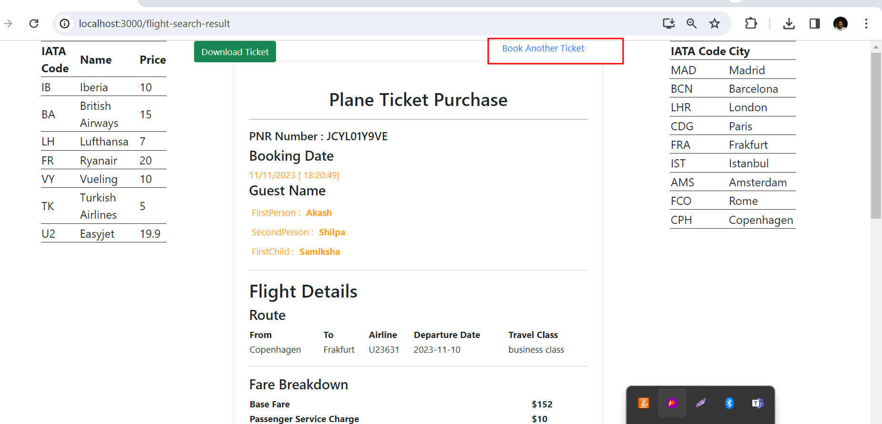

Slide 23
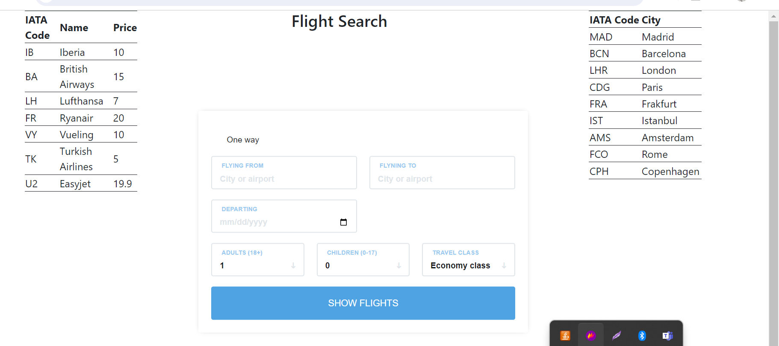

Slide 24
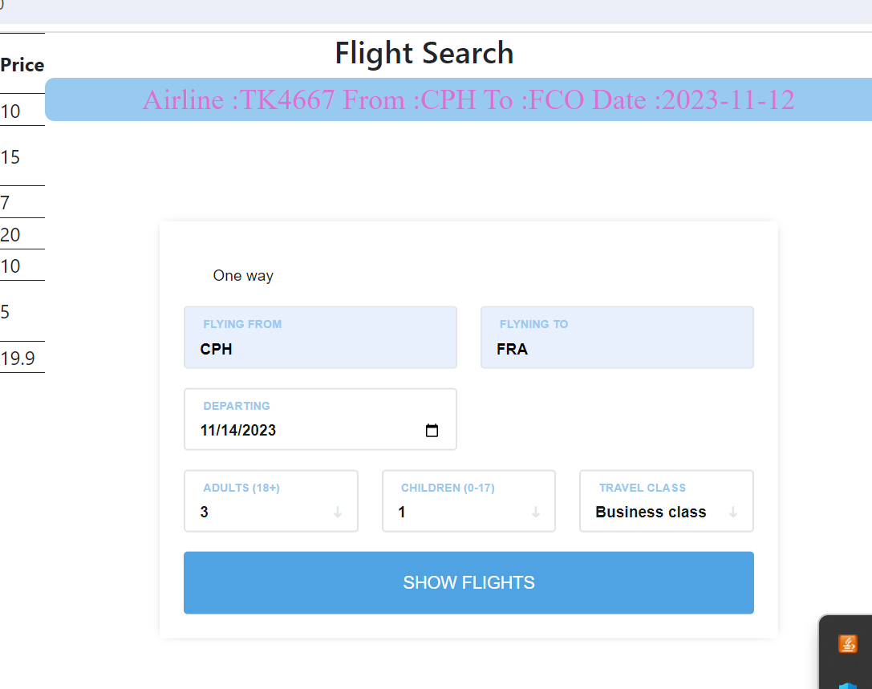

Slide 25
